Slide 1
ERASMUS
EUROPE MAP
How to: Make your Website!

Slide 2
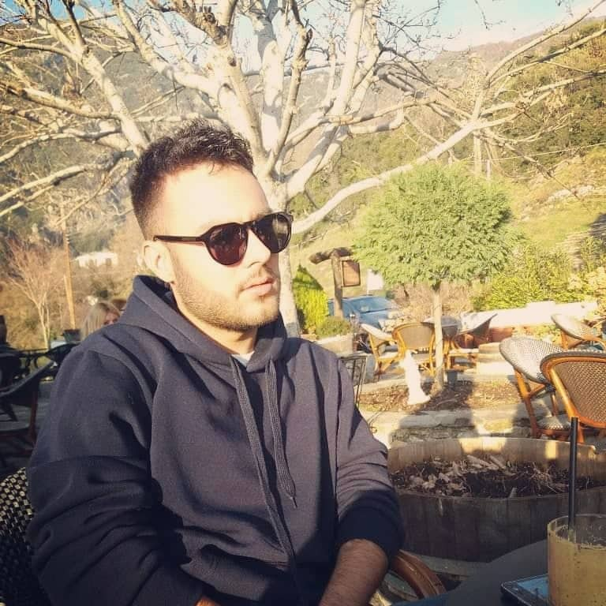
Our Life History
My name is George Lamberis, I am 20 years old and I was born in Volos. In recent years I live in the neighborhood of Nea Ionia Volou and I was a student of the school where we are. After the state examinations of the education system, I started studying in the department of Electrical and Computer Engineering, University of Thessaly. I am in the third year of studies of the total five. Because of the subject of my school, I was assigned by my old professors to carry out the current workshop with the help of some classmates.

Slide 3
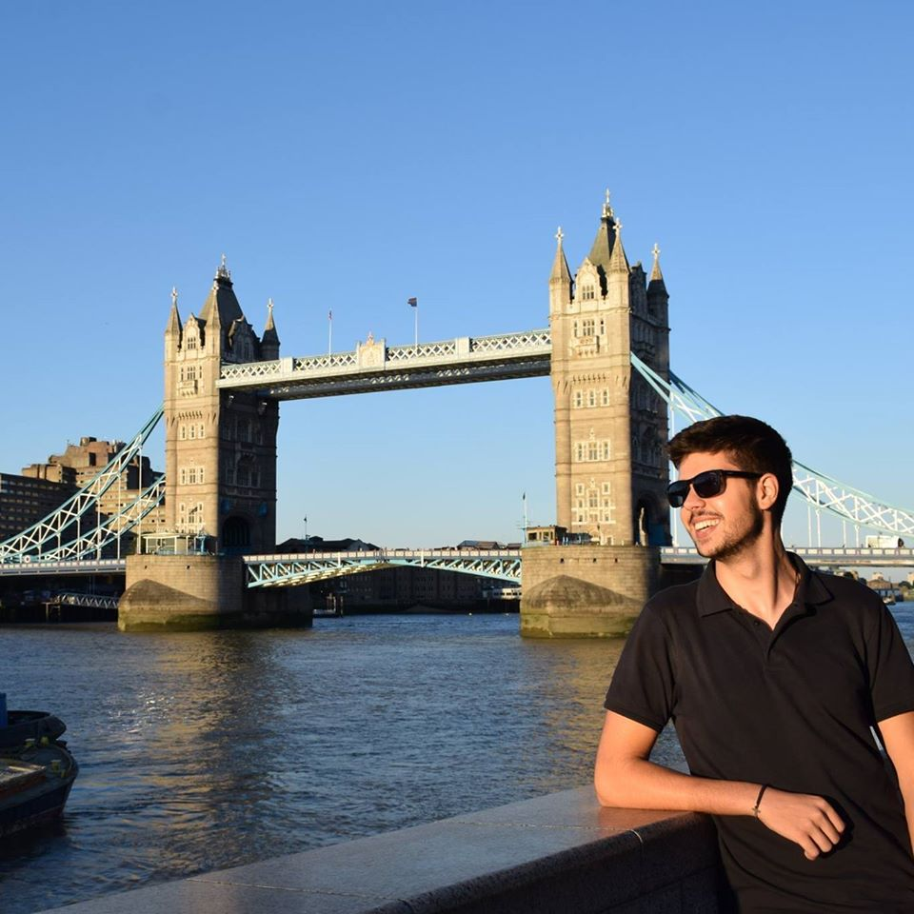
Our Life History
My name is Panagiotis Tsoukas, I am 21 years old and I was born in Athens. In recent years I live in Volos and I was a student of Experimental High School of Mytilene of the University of the Aegean.After the state examinations of the education system, I started studying in the department of Electrical and Computer Engineering, University of Thessaly. I am in the third year of studies of the total five. Because of the subject of my school, I was assigned by Giorgos Lamperis to carry out the current workshop.

Slide 4

Our Life History
My name is Fotini Zakzagki,I am 20 years old and I was born in Larissa. In recent years I live in Volos and I was a student at the 6th High School of Larisa. After the state examinations of the education system, I started studying in the department of Electrical and Computer Engineering, University of Thessaly. I currently am in the 3rd year of the total 5. Because of the subject of my school, I was assigned by Giorgos Lamperis to carry out the current workshop.

Slide 5
What is a website?

Slide 6
What is a website?
A website is a collection of related network web resources, such as web pages, multimedia content, which are typically identified with a common domain name, and published on at least one web server.

Slide 7
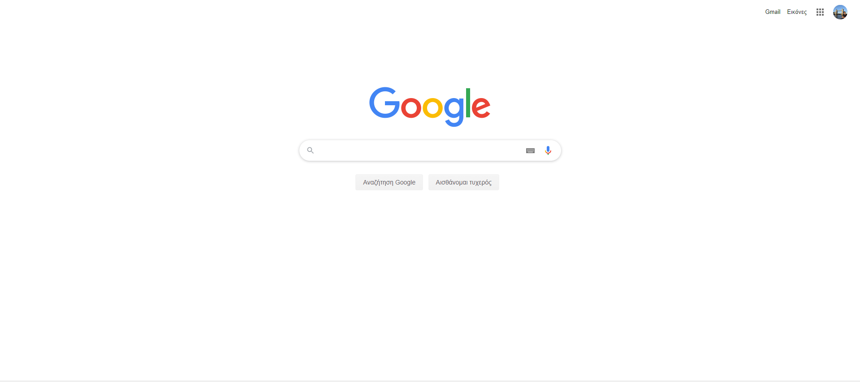

Slide 8
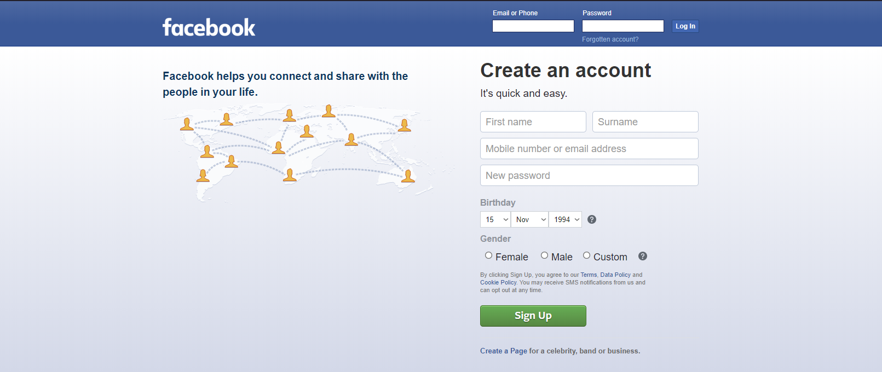

Slide 9
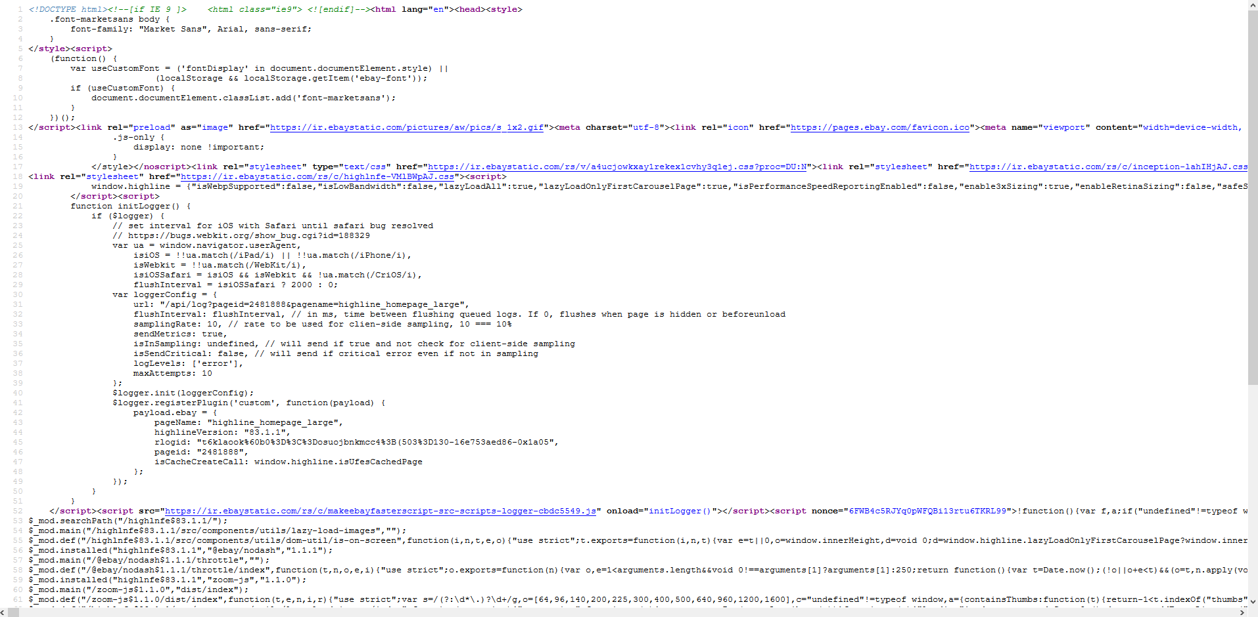
What a website looks like

Slide 10
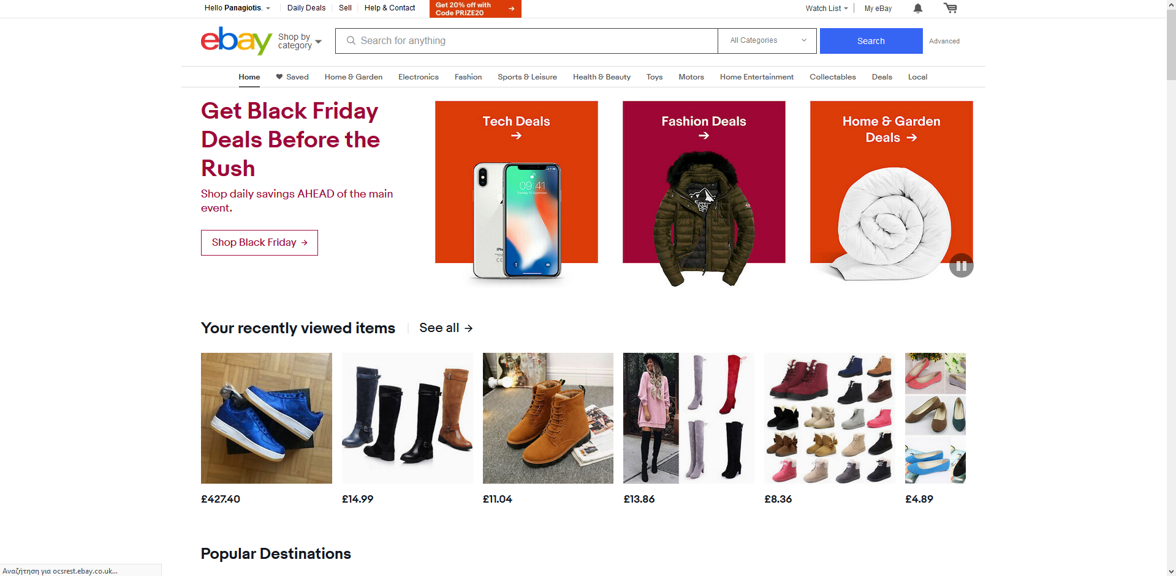
What we see…

Slide 11

Does our location affect our ability to access a website?

Slide 12
How to build a website
Set up domain name
Set up hosting
Create website

Slide 13
What is a domain name?
A domain name is an identification string that defines a realm of administrative autonomy, authority or control within the Internet. Domain names are used in various networking contexts and for application-specific naming and addressing purposes. In general, a domain name identifies a network domain, or it represents an Internet Protocol (IP) resource, such as a personal computer used to access the Internet, a server computer hosting a web site, or the web site itself or any other service communicated via the Internet.
Domain names are hosted in servers.

Slide 14
What is a domain name?
More specifically:
A website like ebay has many different domain names i.e ebay.com , ebay.co.uk, ebay.de, ebay.fr. The different abbreviations are the different domains.

Slide 15

What is a Server?
A web server is server software, or hardware dedicated to running said software, that can satisfy World Wide Web client requests. A web server can, in general, contain one or more websites.
The primary function of a web server is to store, process and deliver web pages to clients. The communication between client and server takes place using the Hypertext Transfer Protocol (HTTP). Pages delivered are most frequently HTML documents, which may include images, style sheets and scripts in addition to the text content.

Slide 16
What is Hosting?
Web hosting is a service that allows organizations and individuals to post a website or web page onto the Internet. A web host, or web hosting service provider, is a business that provides the technologies and services needed for the website or webpage to be viewed in the Internet.
The Best Web Hosting Providers for 2019:
Bluehost.
DreamHost.
HostGator.
A2 Hosting.
InMotion Hosting.
MochaHost.
Web Hosting Hub.
SiteGround.

Slide 17
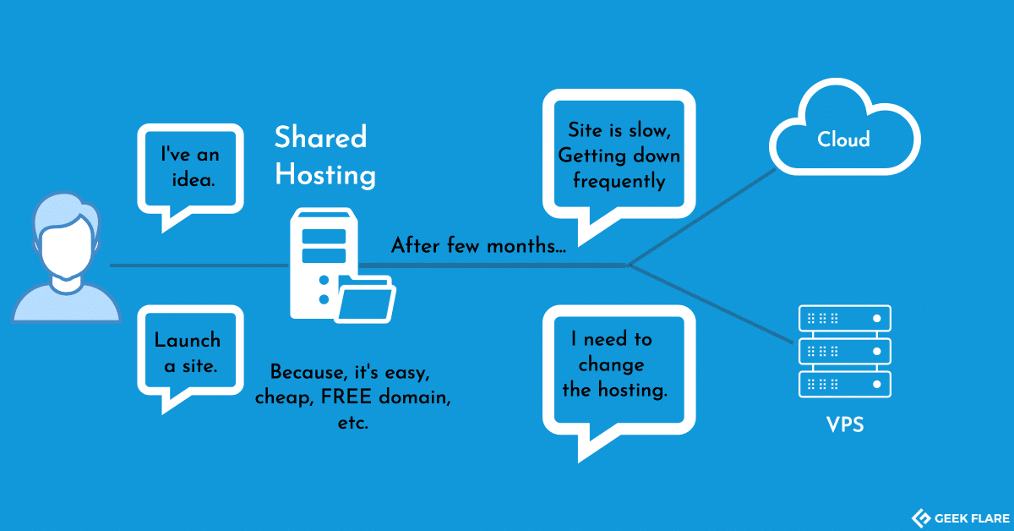

Slide 18
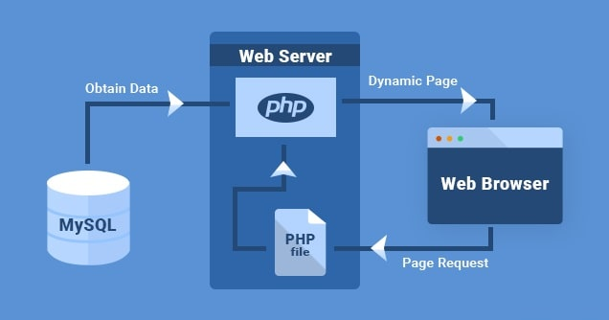

Slide 19
Steps How to:
Make A Wix Website…

Slide 20
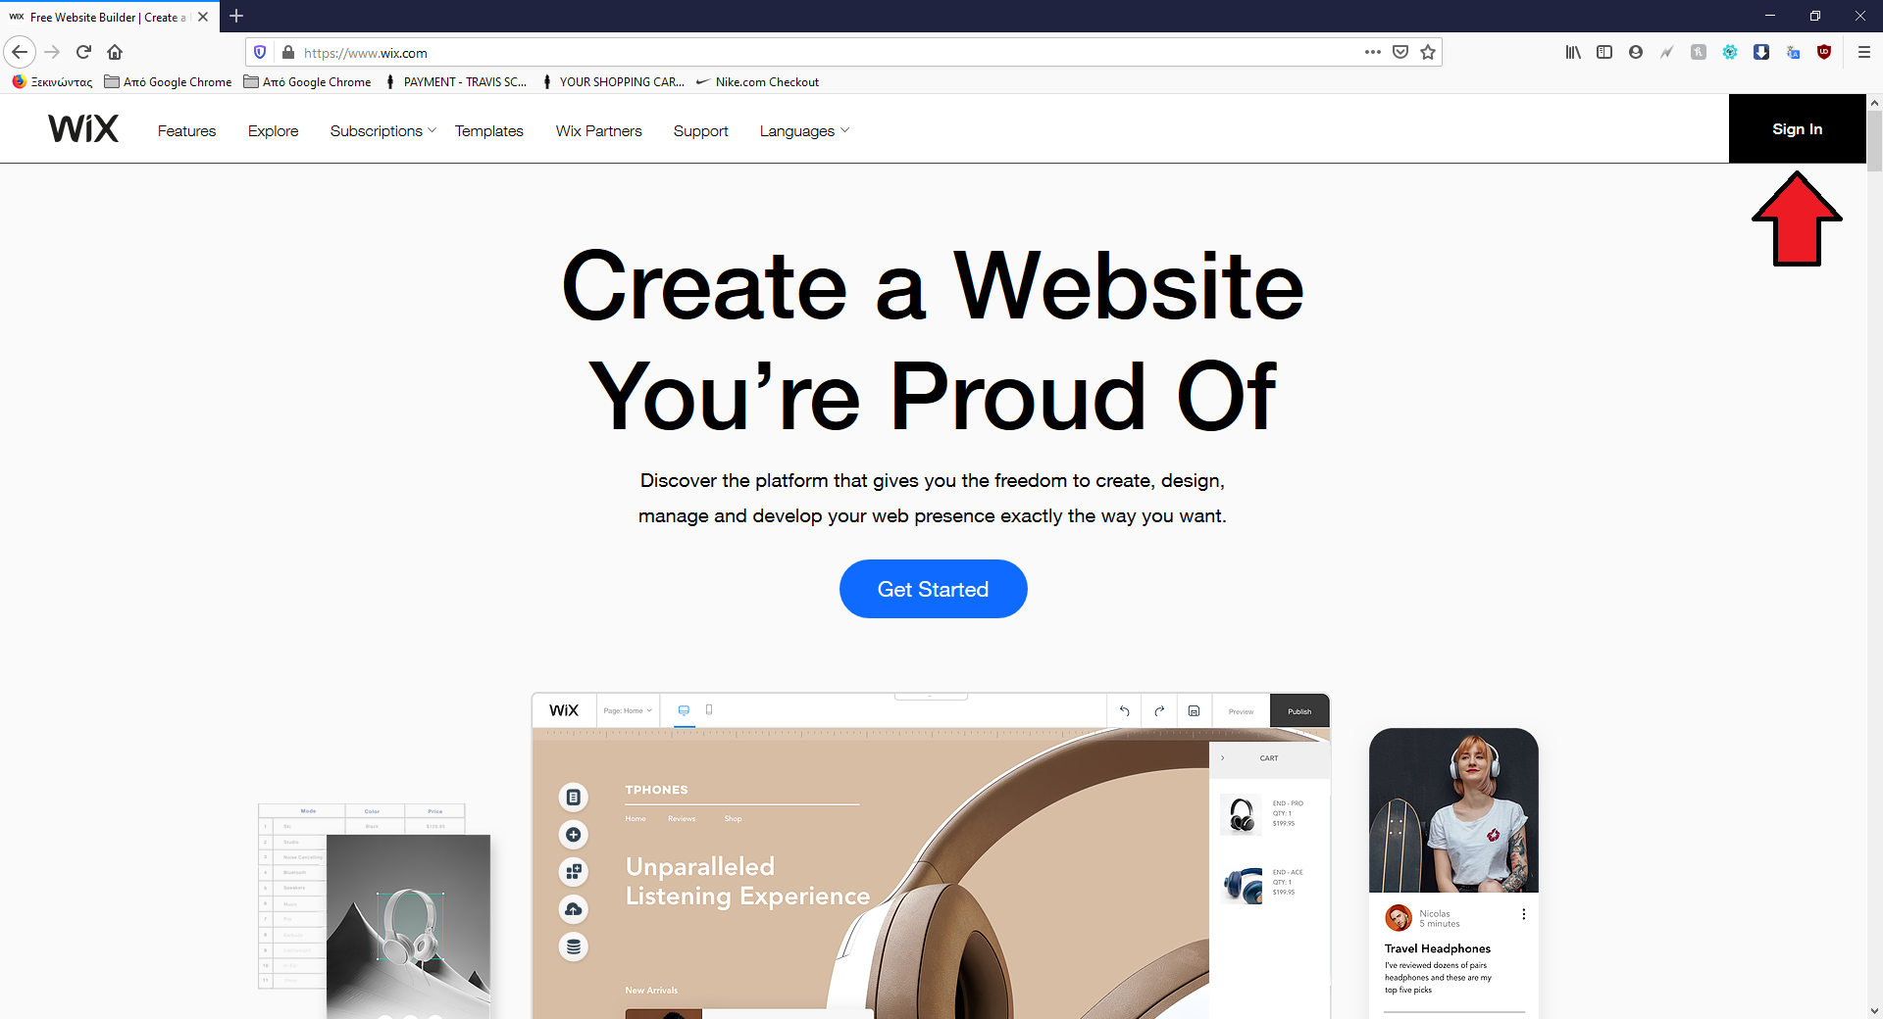
Step 1

Slide 21
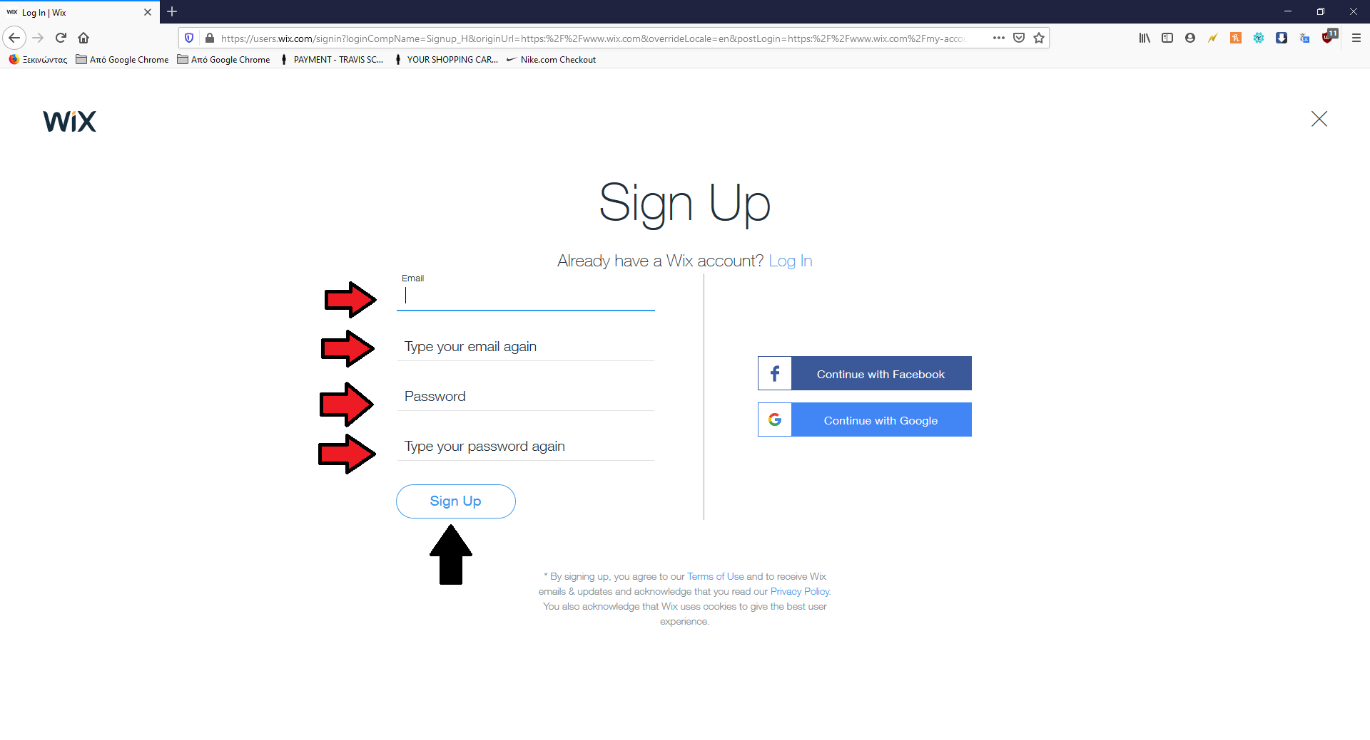
Step 2

Slide 22
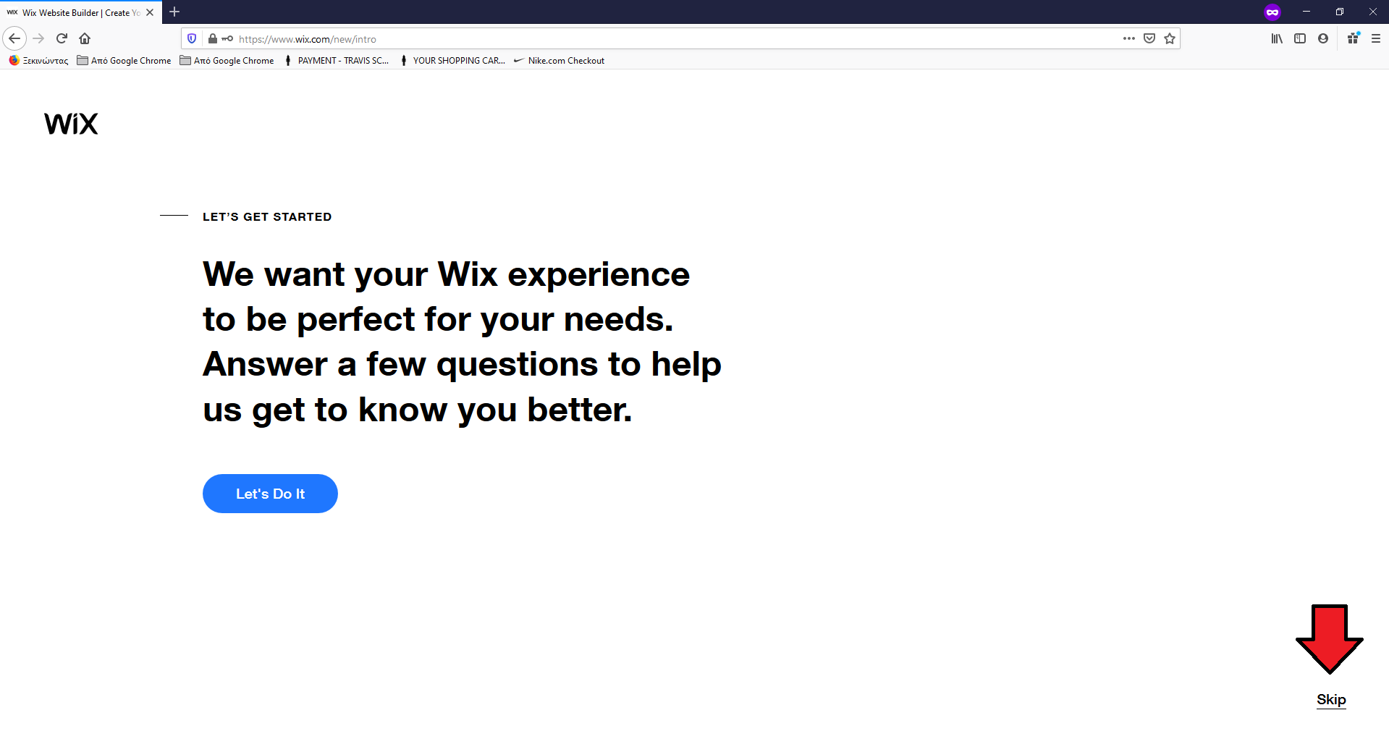
Step 3

Slide 23
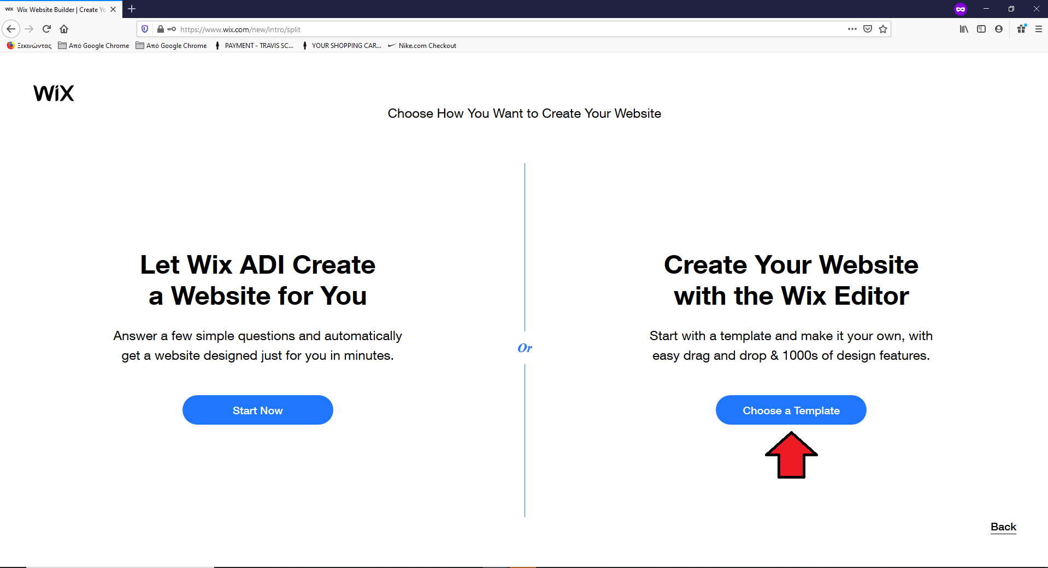
Step 4

Slide 24
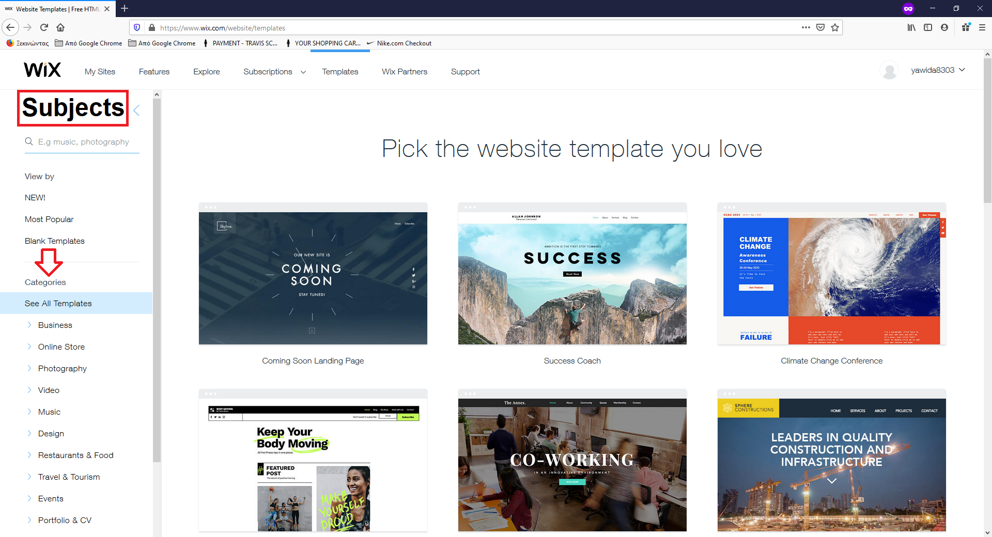
Step 5

Slide 25
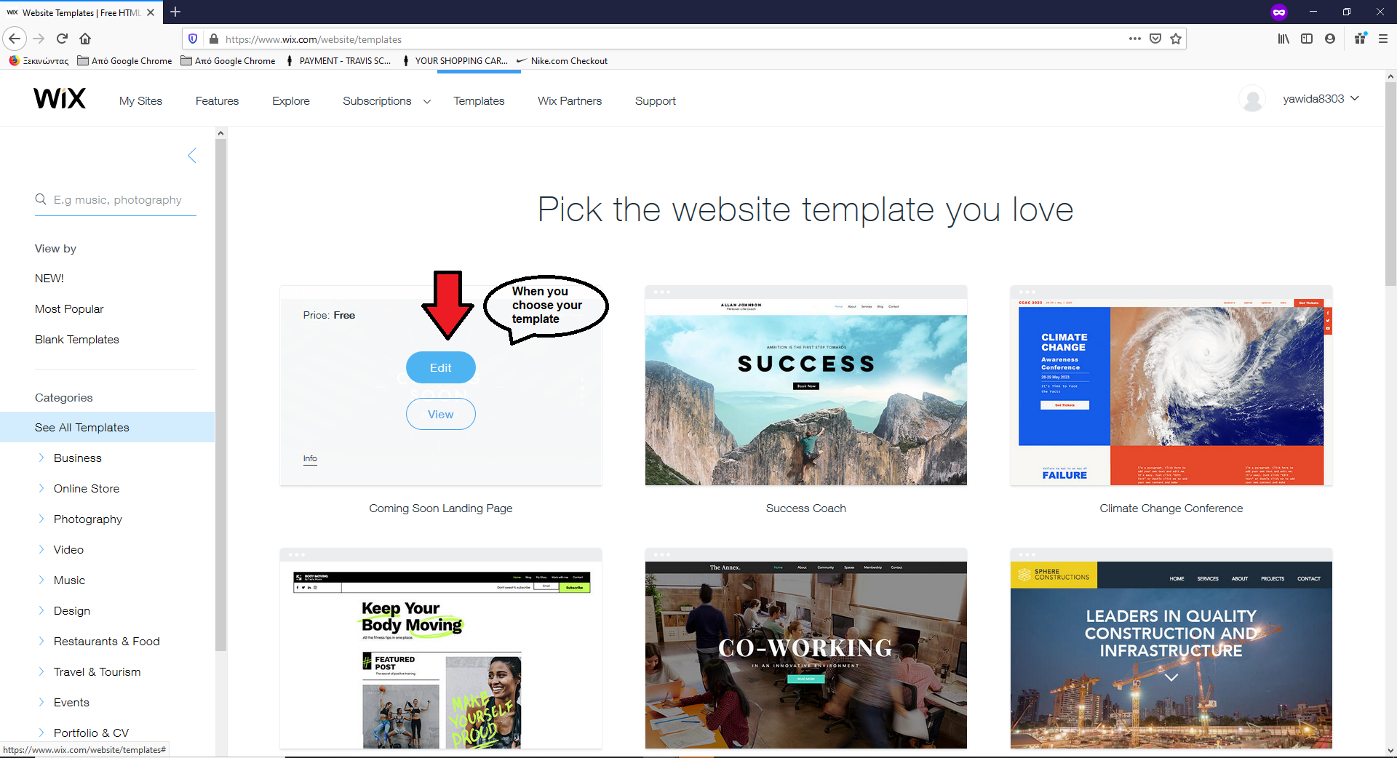
Step 6

Slide 26
Thank You
See you tomorrow…

